Slide 1
CEBAF Accelerator Status
Arne Freyberger
Operations Department
Accelerator Division
Jefferson Lab

Slide 2
Outline
Accelerator Management Changes
FY17 Accelerator Operations
Fall 2016
Spring 2017
Optimizing 12GeV Operations
Reliability/Availability
Energy Reach
FY18
3+ Hall Operations
Summary

Slide 3
Accelerator Division Leadership
On April 30 Andrew Hutton stepped down as the head Accelerator Division
~10 years as Division Leader
Prior to assuming the Division Leadership, Andrew was Director of Accelerator Operations for ~15 years.
Commissioning of 4 GeV CEBAF
Ramp up to 6 GeV
Recovery post-Hurricane Isabel
Fulvia Pilat has assumed the role of Acting Division leader until the completion of the search for the new Division leader
Fulvia has also accepted the Director of the Research Accelerator Division at SNS and will assume this position in Fall 2017.

Slide 4
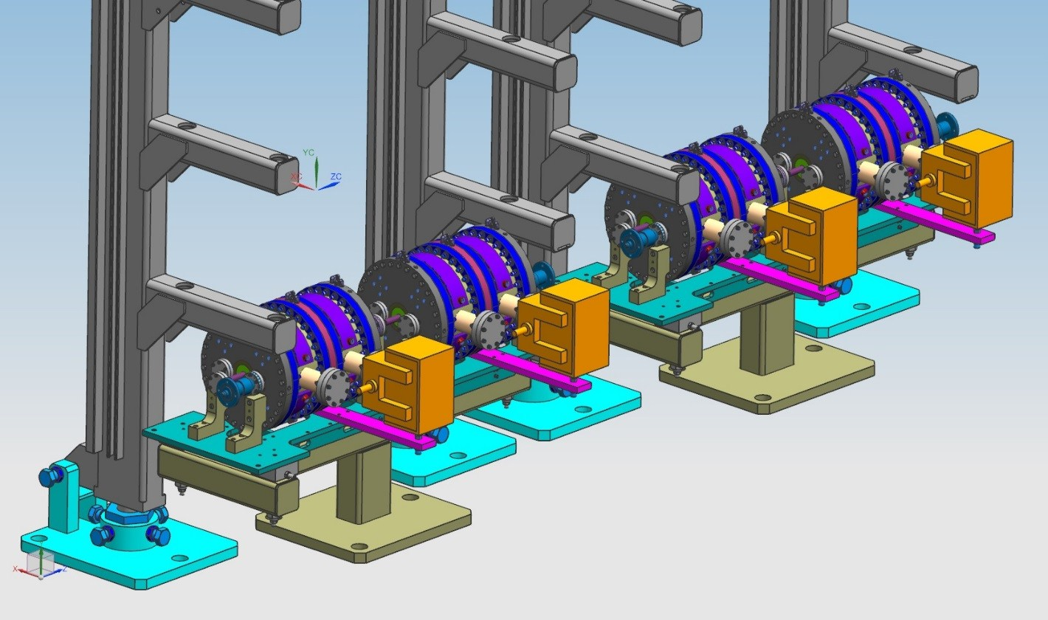
Fall 2016 Accelerator Operations
Hall A (1,3,4,5 passes, 70 uA) & Hall-D 5.5 passes
Linac Energy: 1050 MeV/linac
Commission 5th pass separator
Validate improvements made over the Summer 2016
Compact Geometry (+9%)
Increase RF power (+10%)
Changes validated!
Vacuum leak in one of the cavities immediately following commissioning rained on the parade

Slide 5
Fall 2016 Accelerator Operations
Availability Challenges
Arc7 Box Supply choke failure
Unable to support beam beyond 4th pass, required a change in program.
One of 12 new large box power supplies
Design flaw in estimating heat generated in choke
Klixons install on all chokes
Infant mortality issue
SRF Warm Poly Window failure
Required thermal cycle to repair and clean beamline vacuum (one-week lost time)
End-of-life issue
Replacing all Poly windows this summer with ceramic
South Access Main 1 Feed issues
Persistent ground fault, jumpered out

Slide 6
Spring 2017 Accelerator Operations
2+ Hall Operations
Hall-D 5.5 passes (first production run of GlueX)
Hall-B&C @ 3-pass (KPP)
Hall-A 1-pass
Linac Energy: 1050 MeV/linac
Commission 5th pass separator (AGAIN, after vacuum repair)
All Good!
Hall-D received the majority of its beam using 5th pass separator
5th pass separator operated week(s?) without a trip.
Hall-B and C KPP complete!
End of beam related 12 GeV Project activities
3-hall operations with two high current halls (A&C) established

Slide 7
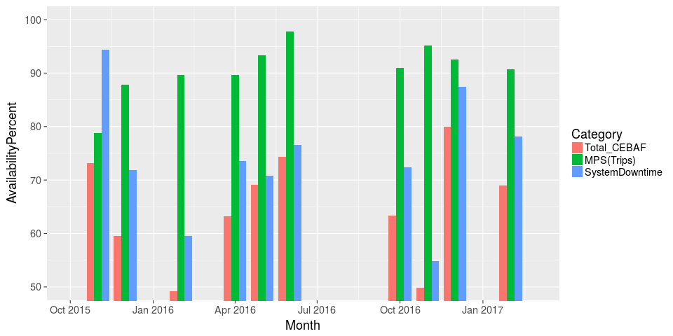
Availability Challenges
Low energy running for PRad
Peak Month to date

Slide 8
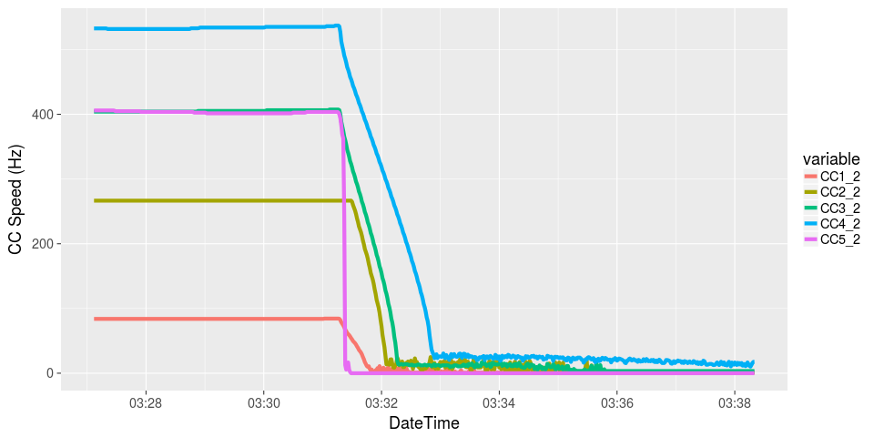
Cryogenic Status
Spring 2017 run was going well up to March 9th 2017
CHL1->SC1 tripped off in the evening
Recovered and tripped in the early morning of March 10th
Cold Compressor 5 (CC5) inoperable post 2nd trip.

Slide 9
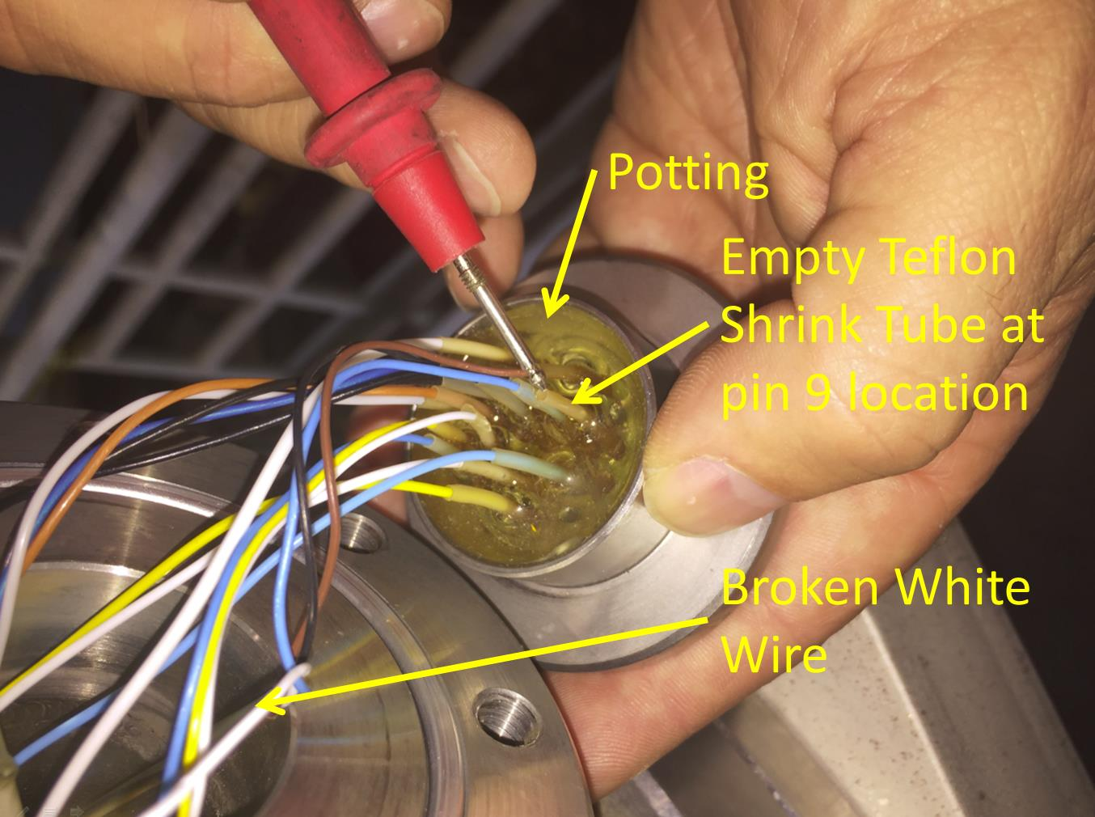
Cryo: CHL1->SC1->CC5 Update
2017-05-02: Broken wire on magnetic bearing connector was found.

Slide 10
Optimizing 12GeV Operations
Reliability/Availability Focus
Improved Linac/Cryogenic changes: Reduce risk of cryoplant contamination
Linac LHe Pressure
Identifying errant magnets
4-Hall Operations
Energy Reach
Linac energy setting: margin -> reliable operations
Identifying source SRF Particulate
Cleaning/processing warm girder regions
Improved in tunnel vacuum procedures
C75 Upgrade

Slide 11
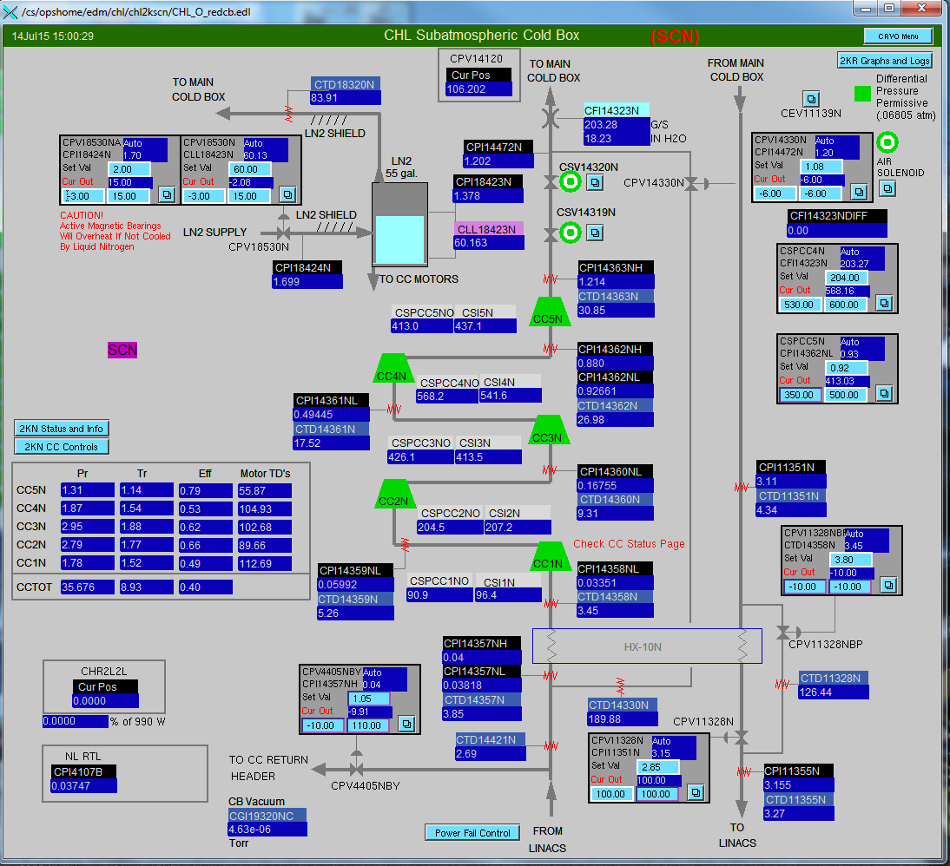
Reducing Risk of Cryoplant Contamination
Contamination in the LHe volume migrates to the heat exchangers (HX) in the 2K cold-boxes (SC1 & SC2)
Spring 2015 and Spring 2016 contamination events
Takes weeks to warm-up and recover
Source of contaminants likely from numerous cryomodule connects and disconnects from the sub-atmospheric system.
HX
Since Summer 2016 new procedure for connecting/disconnecting systems from the LHe supply
Linac must be transitioned to 4K atmospheric before connecting or discconnecting systems
Fall 2016 and Spring 2017 no contamination events

Slide 12
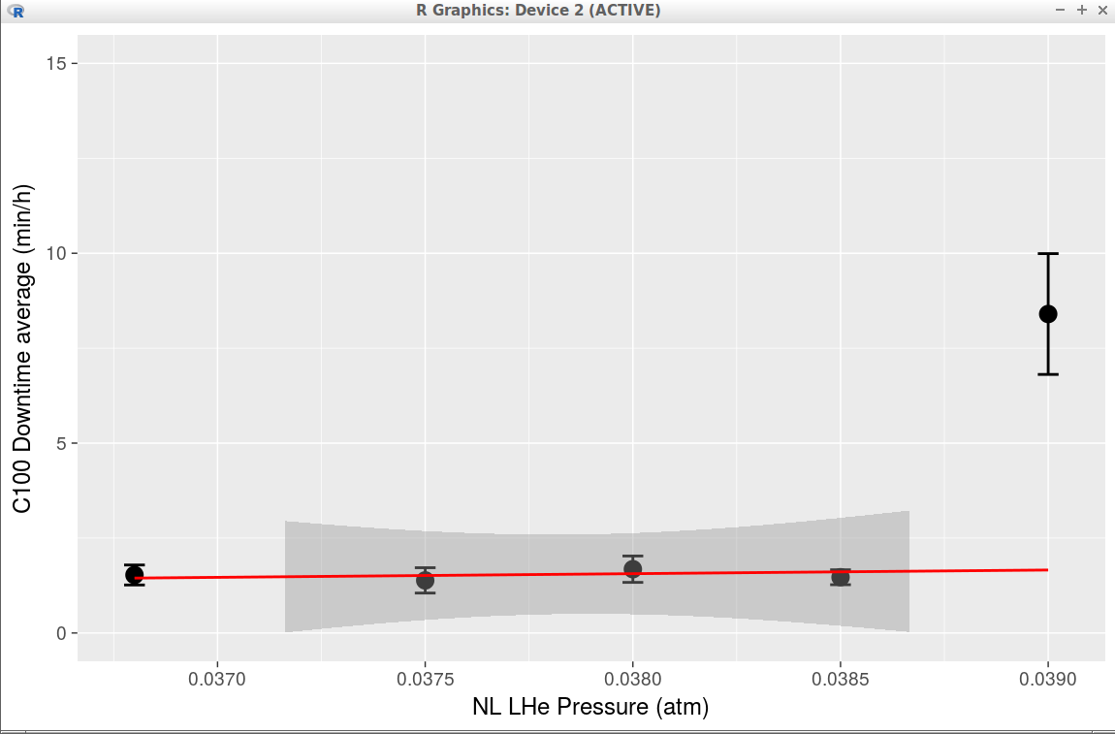
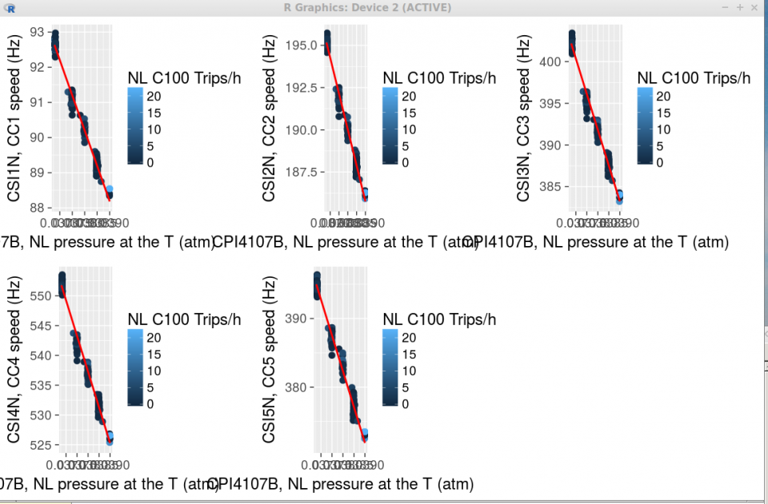
Optimizing 12 GeV Operations: SRF/Cryo
LHe Pressure:
Higher operating pressure -> less stress on 2K cold-box compressors
~2milli-atm of pressure margin availabe
All CC spin reduced
CC4:
552 Hz -> 532 Hz

Slide 13
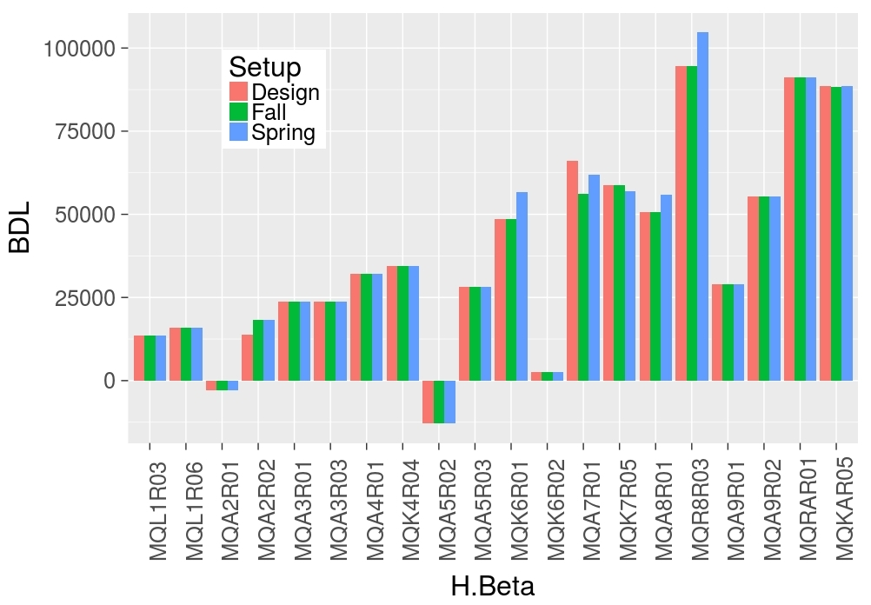
Optimizing 12 GeV Operations: Optics
The 2R Optics Anomaly
Optics matching consistently required MQA2R02 quadrupole set 30% off design.
Detective work by Tiefenback identified MQA2R09 quad as problematic
Confirmed with magnet coil resistance and pole field measurements

Slide 14
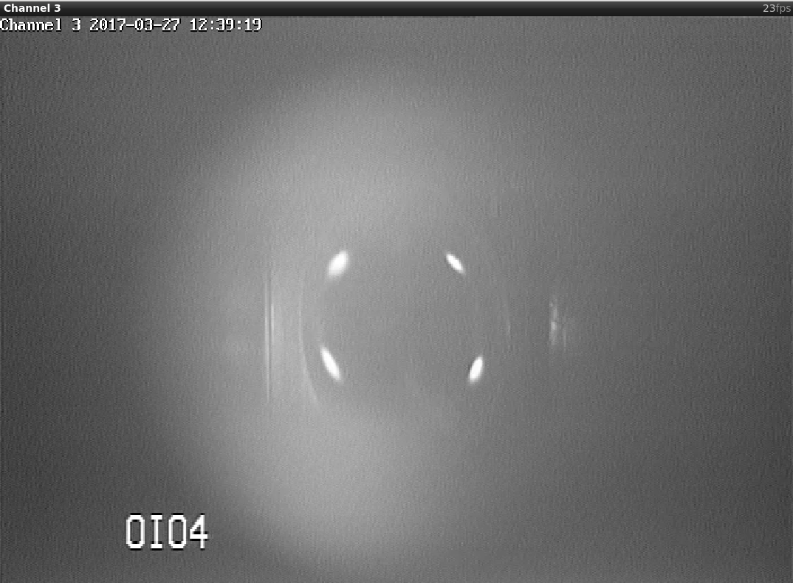
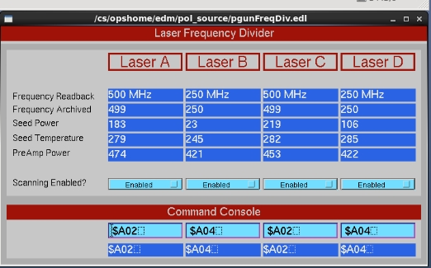
Optimizing 12 GeV Operations: 4-Hall OPS
Laser table upgrade completed Summer 2016
750 MHz 5th pass separators completed/commissioned Spring 2017
Laser RF controls completed April 2017
System pieces are complete
Full integrated system tests this Fall

Slide 15
Energy Reach
CEBAF C20 RF trip rate is a function of cavity gradient
Well modeled by Linac Energy Manager with frequent cavity parameter updates from Benesch
Operations requires sufficient gradient margin so that emergent problematic cavities do not derail the program (CEBAF down hard)
Margin of 60 MeV/linac at the start of each FY
Provides enough margin to deal with entire C20/C50 cryomodule
Determine Energy setting that results in 8 RF trips/h from C20 modules (assume C50/C100 contribute another 2 trips/h)
Subtract 60 MeV/linac from this value to determine the maximum linac energy gain allowed.
E_{linac} < E_{8trips/h} - 60 MeV

Slide 16
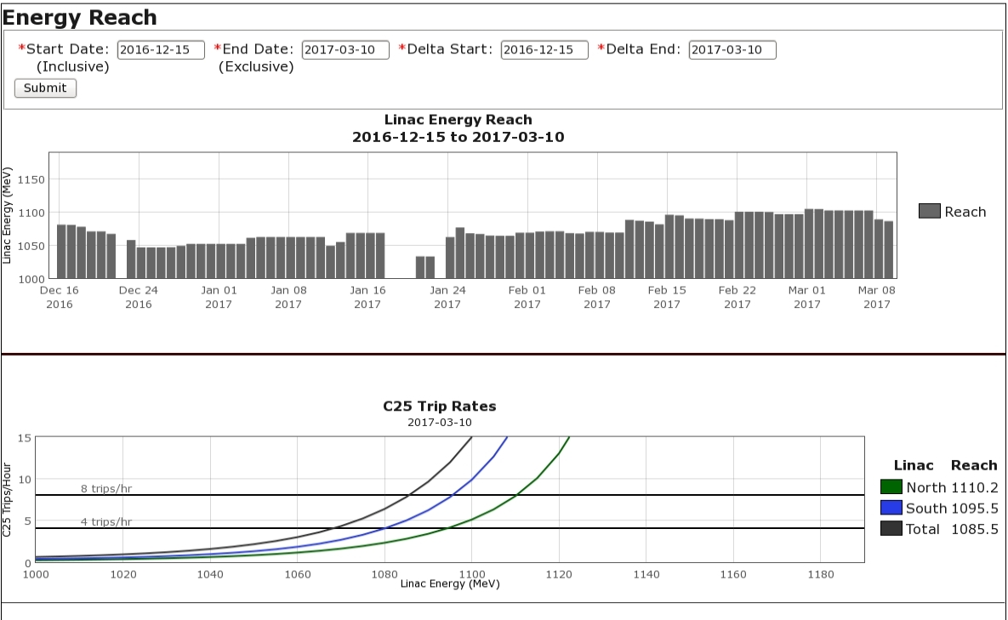
Energy Reach
Linac Energy that would result in ~ 10 trips/h

Slide 17
Optimizing 12 GeV: Search for new Field Emitters Source in Cryomodules
New field emitters on SRF surface results in degradation of operational gradient.
Historical average of the loss is ~34 MeV/pass/year
A hunt for the source of the new field emitters has been ongoing (led by Geng, Reece, & SRF)
Detailed surface analysis has been performed on the last two modules removed from LERF/CEBAF
Particles as large a 1 mm found
Metallic dominates: Steel, Copper
Particulates found on cavity and warm region surfaces

Slide 18
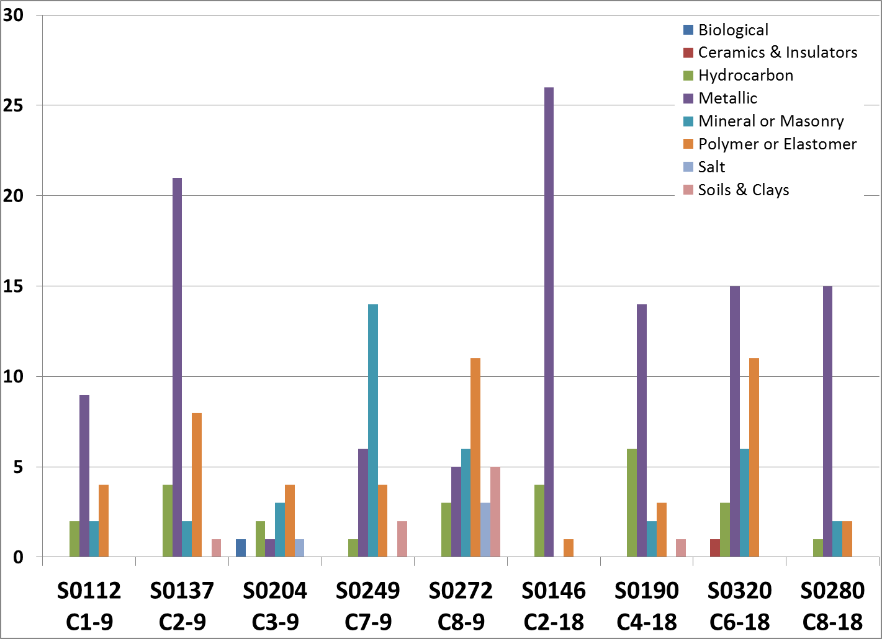
Particle Type Distribution
Cavities
Beamtubes btw cavities
Notes:
18

Slide 19
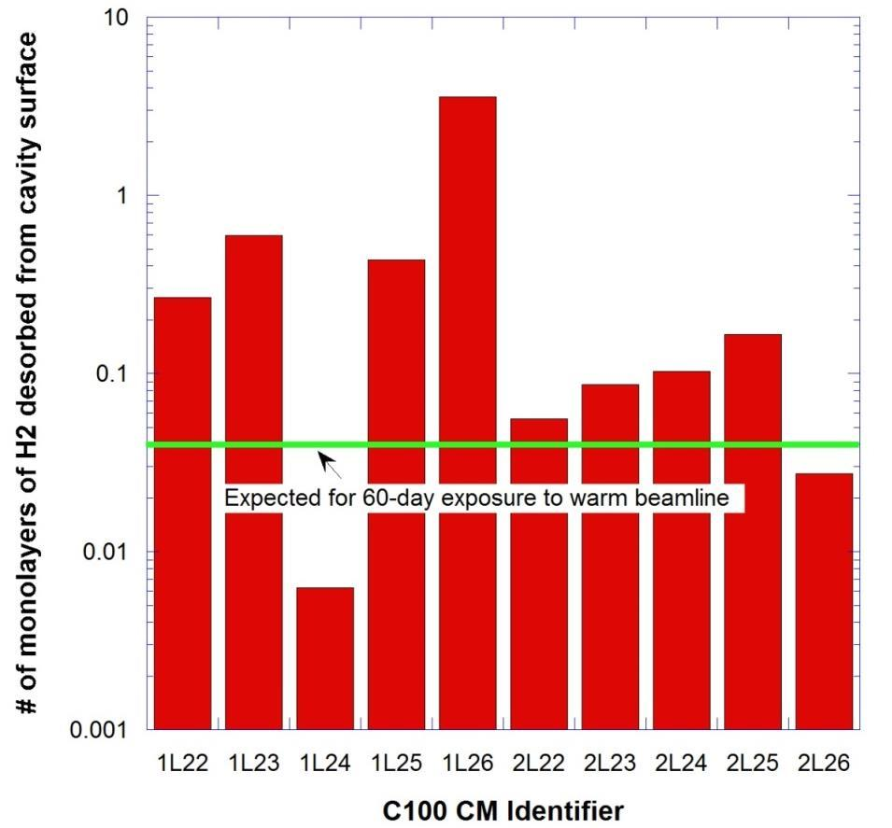
Beyond Particulate: Condensed Hydrogen on Cavity Surface
Condensed Hydrogen on cavity and wave guide surface can acerbate field emission
Perhaps source of C100 excessive quench signatures: Waveguide discharge due to H2
Analysis vacuum levels vs Temperature of C100 warm-up consistent with H2 being release
Levels consistent with H2 desorbed from the warm region
Additional reason for upgrading the warm region pumps
R-L. Geng TN-17-027

Slide 20
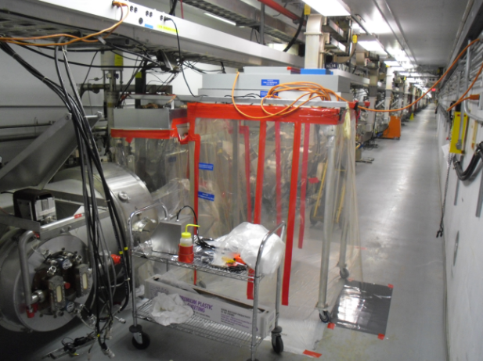
Improved Tunnel Vacuum Procedures and Warm Region Pumps
Particulate found on SRF cavity and warm region surfaces likely sourced in the warm region between girders.
New procedures have been put in place to try to minimize particulate generation and migration
New portable clean rooms constructed
New particle counters purchased and used to establish proper clean room conditions prior to exposing beamline vacuum to air
Clean-room attire used inside the clean room.
Warm regions that connect to refurbished cryomodules (C50s) are processed/cleaned by SRF prior to connecting to the fresh C50
C50/C75 upgrades now include modern ion/neg pumps for increased pump capacity and less particulate generation

Slide 21
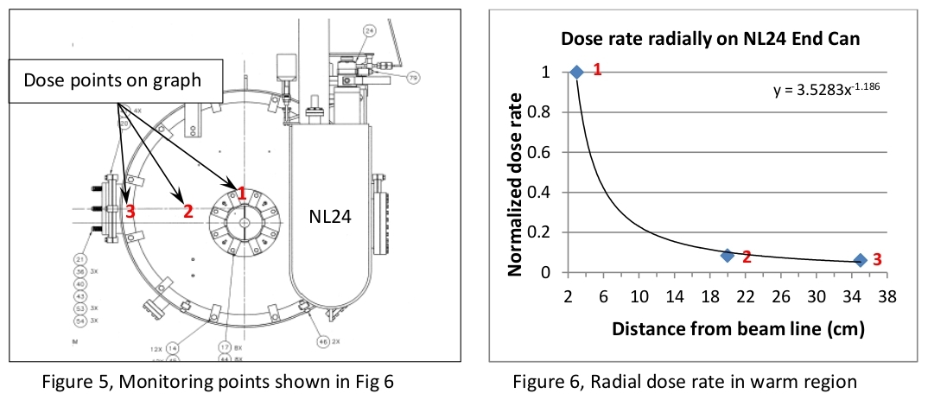
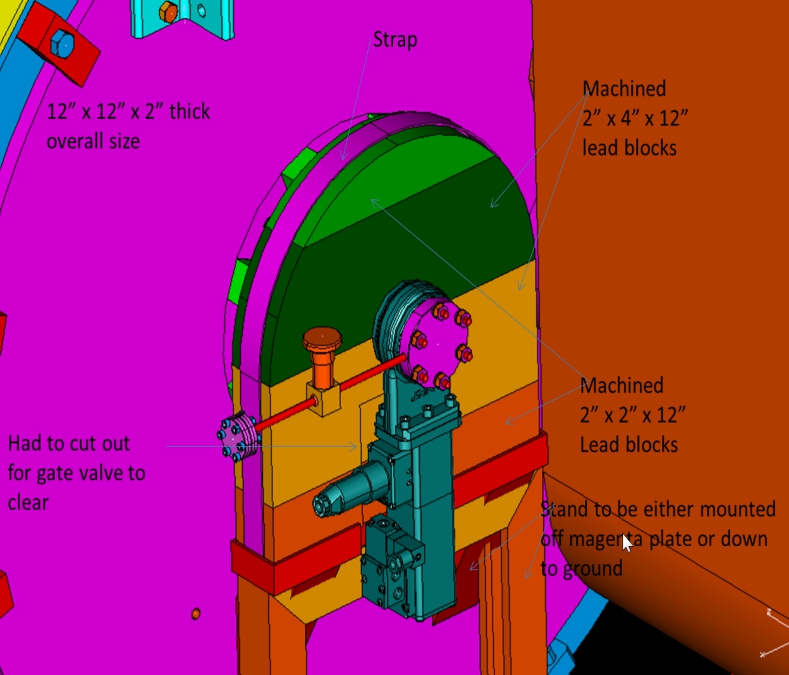
C100 Field Emission induced Radiation Damage
Experience radiation damage in C100 warm girder regions
Vacuum systems in particular: random valve closings
Installing lead collars on C100 exits to minimize the damage
Does not protect the cryomodule, C100 lifetime at risk
See George K. presentation at 2016 OPS StayTreat

Slide 22
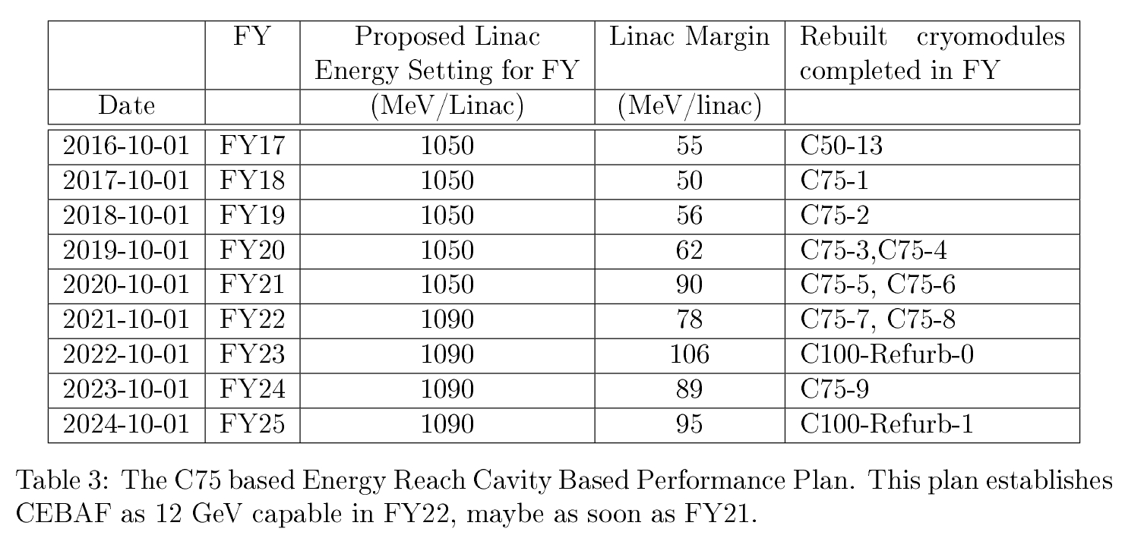
C75 Plan
Proposed path to design energy (1090 MeV/linac)
Comparable in scope to C50 program post hurricane Isable
If annual degradation is mitigated: might achieve 1090 MeV/linac by FY21

Slide 23
Fall 2017 and beyond
Cryogenics situation still fluid, but…
planning for a 2K operations on two cold-boxes by Sept.
Beam operations resume first week in Oct (start of FY18)
3+ hall operation
Linac Energy: 1050 MeV/linac
Challenges include:
4-hall operation for the first time
Expect lower availability
First time two beam for physics through the same slit
First use of the vertical separators for simultaneous 5th pass beam to A, B or C
Fully loaded linac currents: May push the old compromised klystrons over the edge
There are 50+ klystrons showing end-of-life symptoms

Slide 24
Summary
12 GeV Experimental program established
Hall-A: GMp completed (Hall-A), schedule portion of DVCS completed
Hall-B: PRad completed, HPS engineering run
Hall-D: First production run Spring 2017
12 GeV beam related activities completed
Hall-B KPP
Hall-C KPP
Accelerator Operations continues to dial in 12 GeV performance
Combined effort with CASA, SRF, Engineering, Facilities
Availability Challenges Remain
New systems issues: Box supplies, magnet buses
End-of-life issues: SRF Window failures, SC1 2K cold-box
Performance Plan (JLAB-TN-17-022)
Lack of critical spares
End-of-life issues and obsolescence

Slide 25
Backup

Slide 26
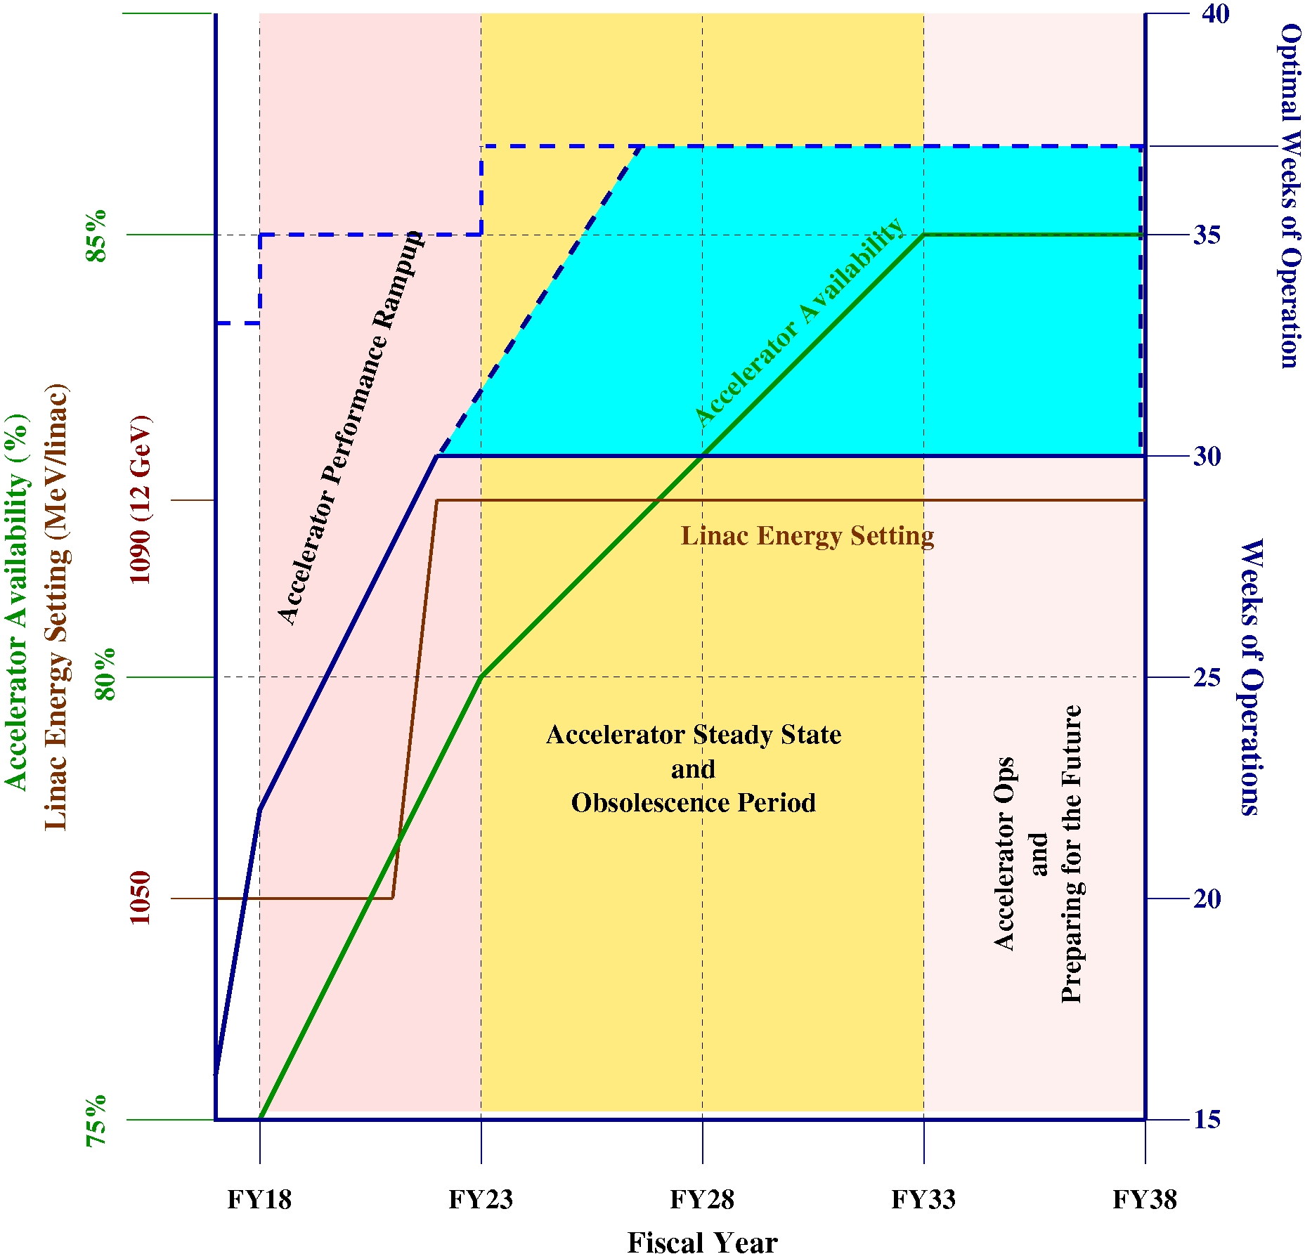
CEBAF Performance Plan (JLAB-TN-17-022)

Slide 27
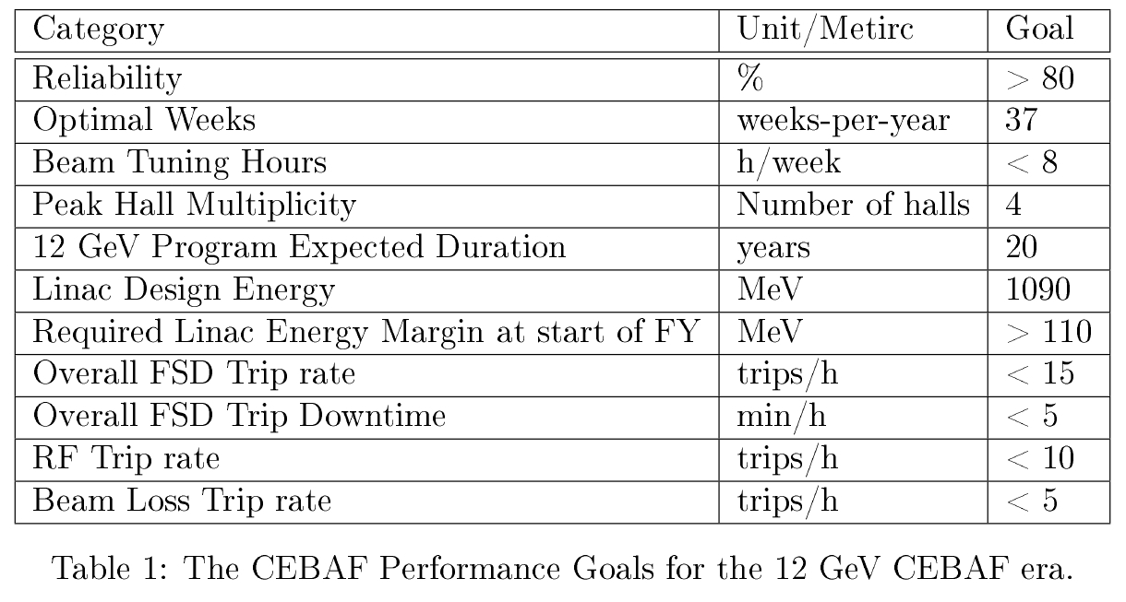
Performance Goals

Slide 28
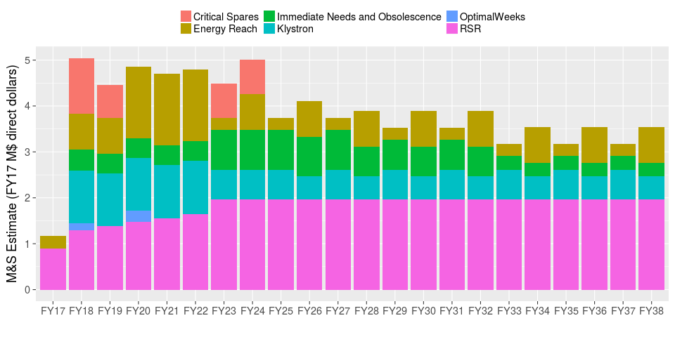
Performance Plan Cost Estimate

Slide 29
4-Hall Operations and Beam Availability
Hall lines contribution to CEBAF Beam Availability.
High current halls tend to have higher rate of MPS (BLMs, Ion Chambers, BLA) faults
More invasive beam tuning for the supported halls.
Expect 10% less Beam Availability for 4-Hall OPS
In terms of Physics hours, 4-Hall ops out performs 3-Hall operations
 | MPS/tuning Impact to a Hall | Physics-per-week
1-Hall Ops | 0.97 | 0.97
2-Hall Ops | 0.94 | 1.88
3-Hall Ops | 0.90 | 2.7
4-Hall Ops | 0.87 | 3.5

